Slide 1
Overcoming the Effects of Climate Change
James Renwick
Victoria University of Wellington
james.renwick@vuw.ac.nz
Bridgebuilders 7th International Consultation 5 April 2014
Notes:
There will be 40-45 women present from many ethnicities and across all ages, many younger women. Delegates will attend from Taiwan, Myanmar, Philippines, Thailand, South Africa, Cook Islands Vanuatu, Kiribati, Samoa and Fiji. Later that day an interactive Workshop on “Overcoming the Effects of climate Change” facilitated by Maleta Tenten from The Kiribati Protestant Church.
Why did we choose the topic of “Overcoming the Effects of Climate Change”?
members were also concerned to improve outcomes for disaster management. This may give you some idea of the practical aspects which women can take up. Climate change will be a new topic for consideration by the Bridgebuilders Network. Because of the increasing impacts in member countries including Kiribati, Philippines and Thailand and in view of New Zealand having a number of experts such as yourself it seemed important in planning for the 7th Consultation to build capacity for those attending in the practical aspects of how the effects of climate change could be mitigated in a practical way in their home communities.

Slide 2
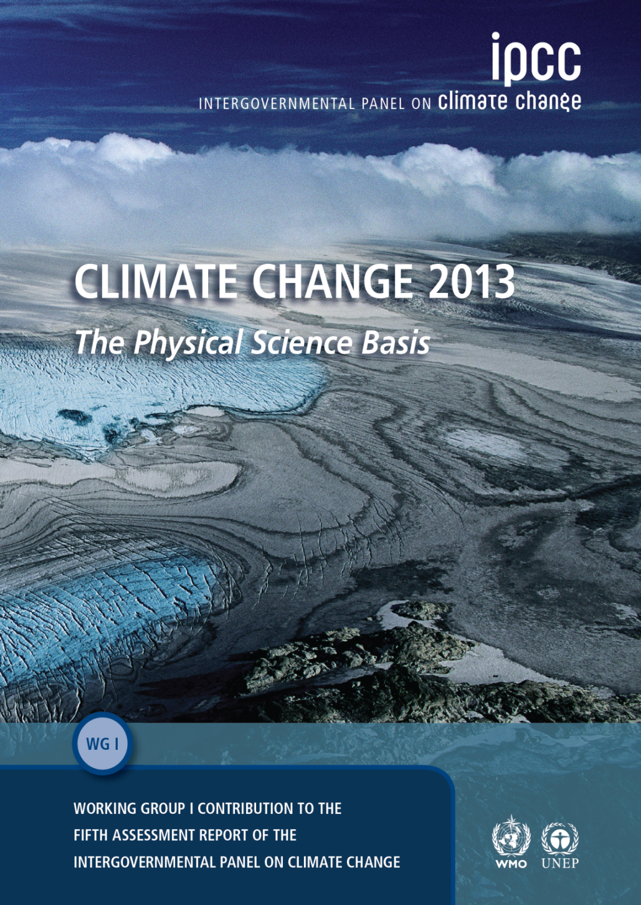
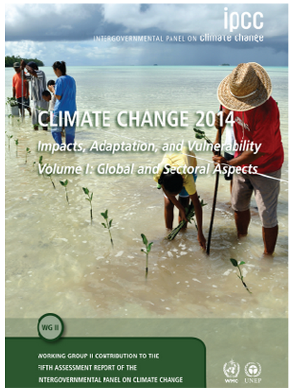
“The AR5”
climatechange2013.org
www.ipcc.ch/report/ar5/wg2/

Slide 3
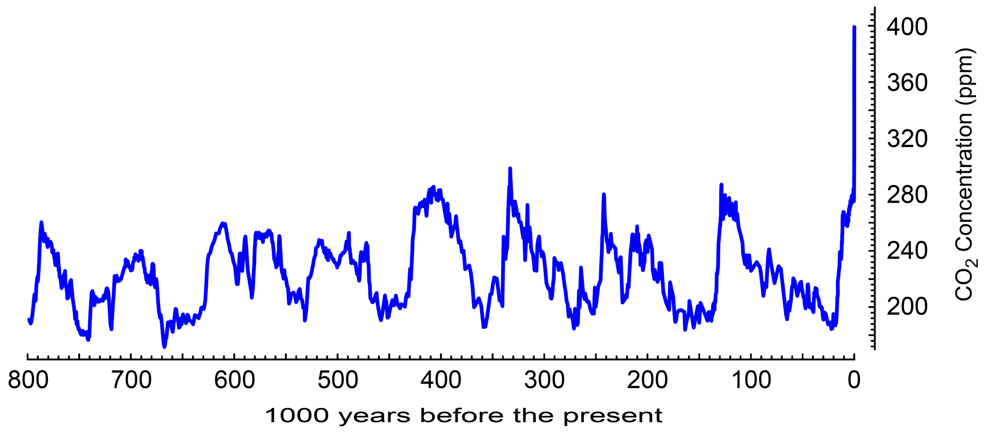
Carbon dioxide concentration: controls the amount of heat the atmosphere absorbs
40% rise to the present
Typical maximum during interglacials
(Lüthi et al.,2008, NOAA)
The atmospheric concentrations of carbon dioxide, methane, and nitrous oxide have increased to levels unprecedented in at least the last 800,000 years.

Slide 4
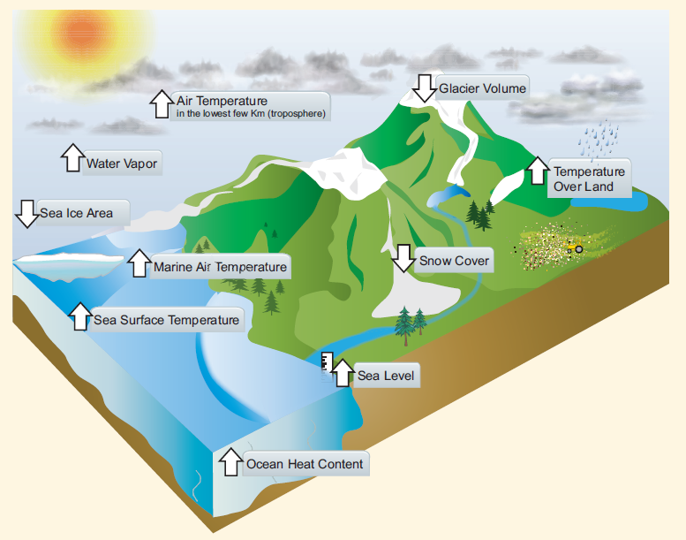
Climate Response

Slide 5
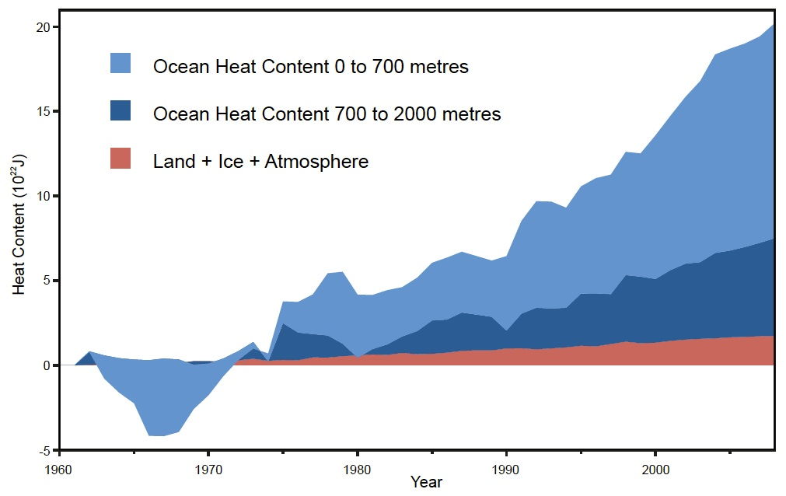
Accumulation of heating
93%
Based on Nuccitelli et al. (2012)

Slide 6
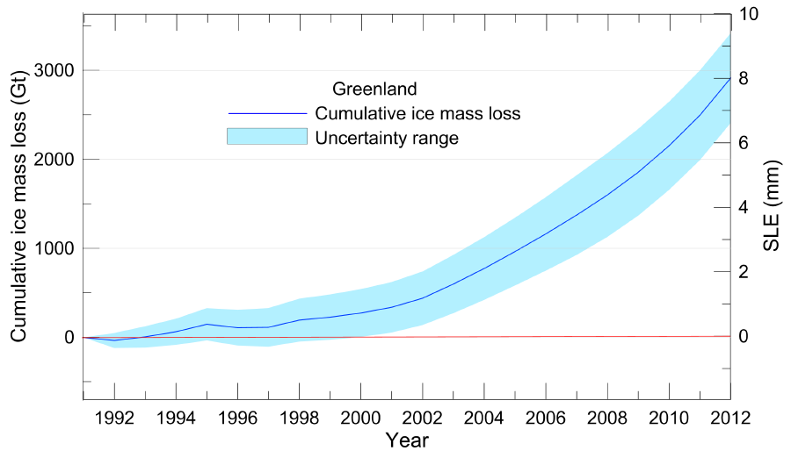
Ice Melt: Greenland

Slide 7
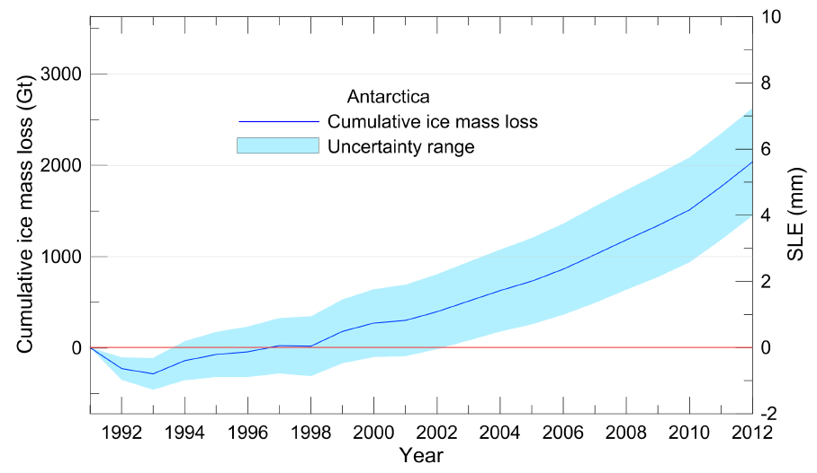
Ice Melt: Antarctica

Slide 8
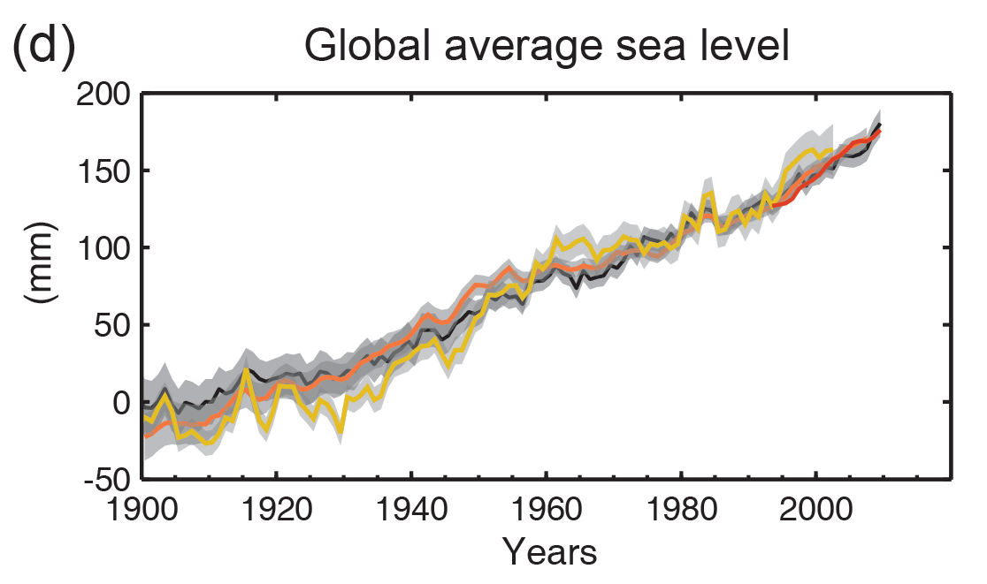
Sea level rise
1901-2010: 1.7 mm/yr
1993-2010: 3.2 mm/yr

Slide 9
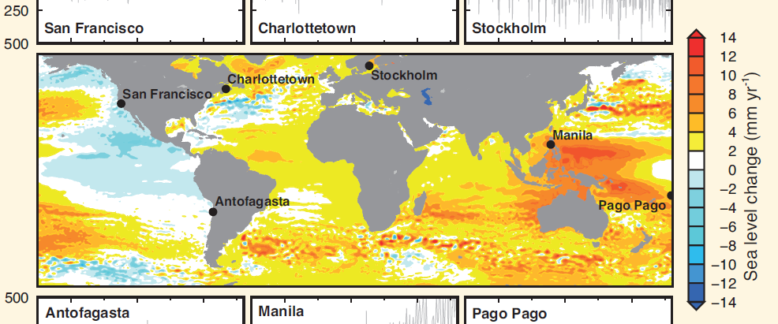
Sea level rise
Trend, 1993-2012 from satellite data

Slide 10
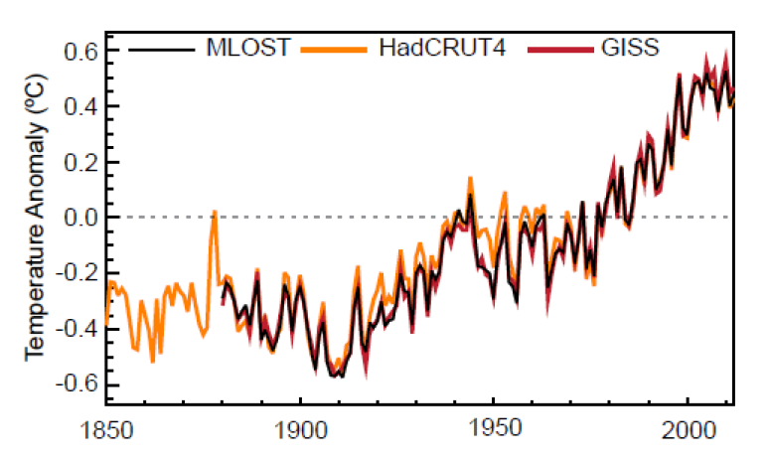
Surface temperature change
Annual average
© IPCC 2013
Each of the last three decades has been successively warmer at the Earth’s surface than any preceding decade since 1850.
In the Northern Hemisphere, 1983–2012 was likely the warmest 30-year period of the last 1400 years (medium confidence).

Slide 11
Many extremes have changed
Phenomenon and direction of trend | Assessment that changes occurred
Fewer cold days and nights | Very likely
More hot days and nights | Very likely
Increases in frequency and/or duration of heat waves | Medium confidence on a global scale Likely in large parts of Europe, Asia and Australia
Increase in the frequency, intensity, and/or amount of heavy precipitation | Likely more land areas with increases than decreases
Increases in intensity and/or duration of drought | Low confidence on a global scale Likely changes in some regions
Increases in intense tropical cyclone activity | Low confidence in long term (centennial) changes
Increased incidence and/or magnitude of extreme high sea level | Likely (since 1970)
Source: SPM Table 1

Slide 12
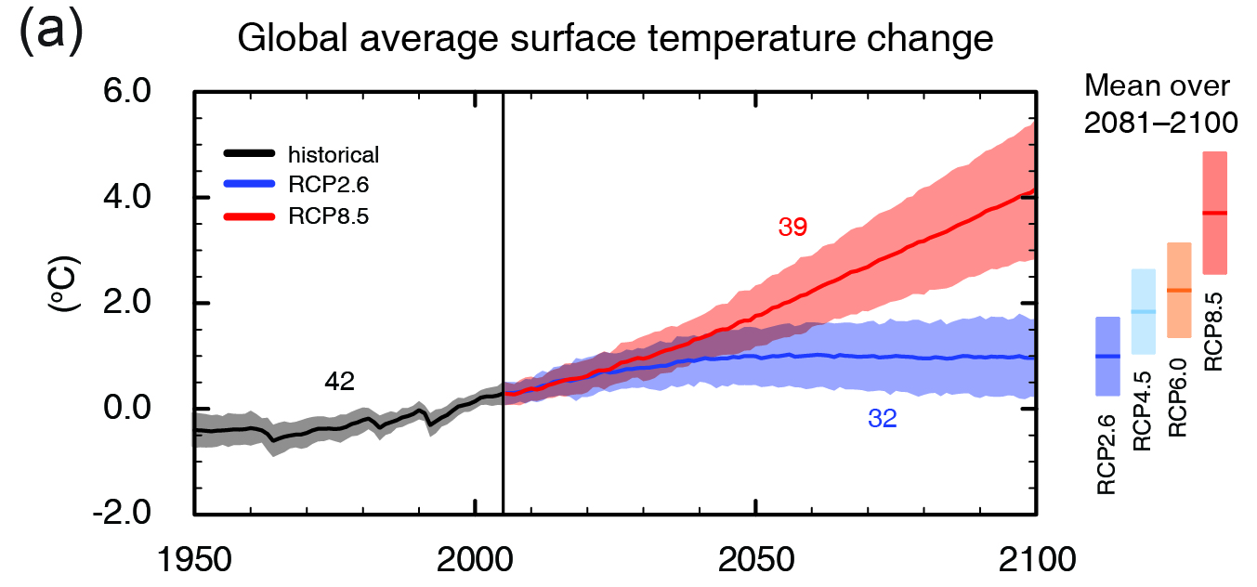
The future
© IPCC 2013
Global surface temperature change for the end of the 21st century is likely to exceed 1.5°C relative to 1850−1900 for all scenarios except RCP2.6.

Slide 13
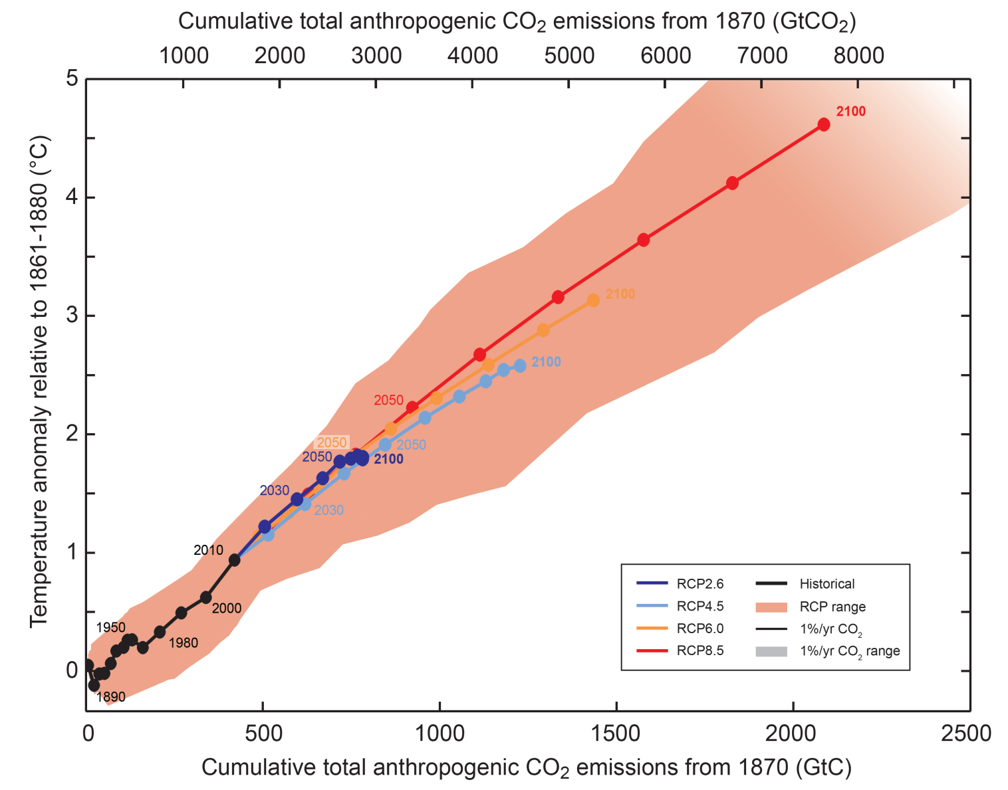
Total emissions and total warming
2100
2100
2100
© IPCC 2013
2100
Limiting climate change will require substantial and sustained reductions of greenhouse gas emissions.

Slide 14
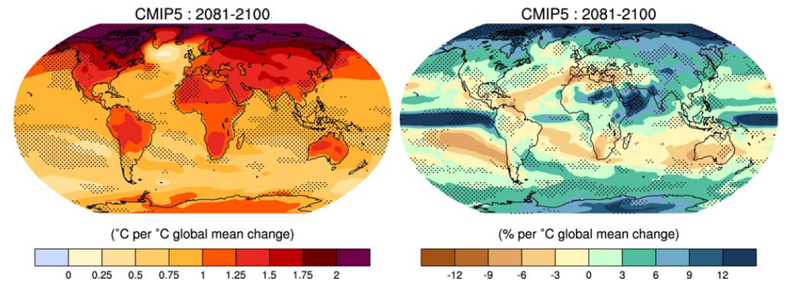
Model global projections: 2081-2100
More moisture in the air
Bigger rainfall variability, stronger monsoons
Wet wetter, dry drier
Increase in extremes: Heavy rain, wind, storms...
Ocean Acidification: Big risks for marine food webs…

Slide 15
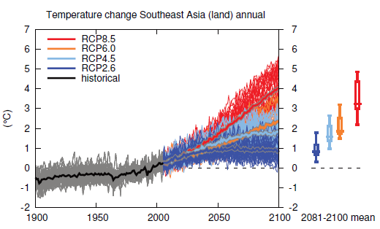
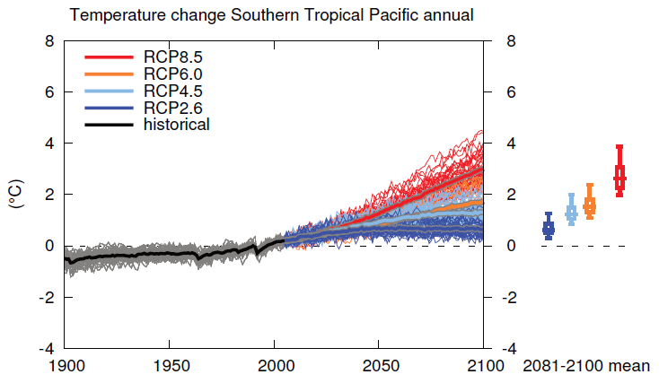
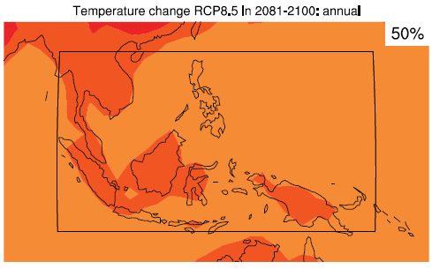
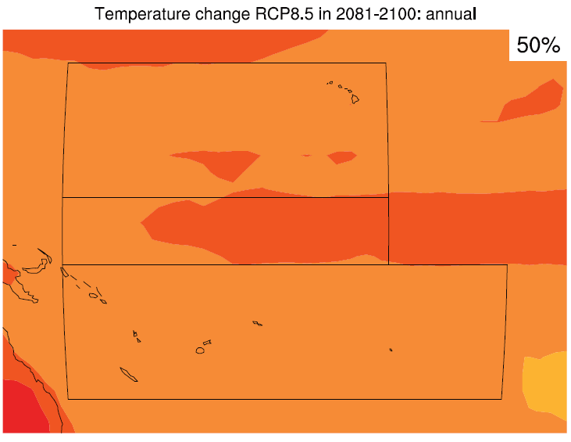
Temperature change: 100 years

Slide 16
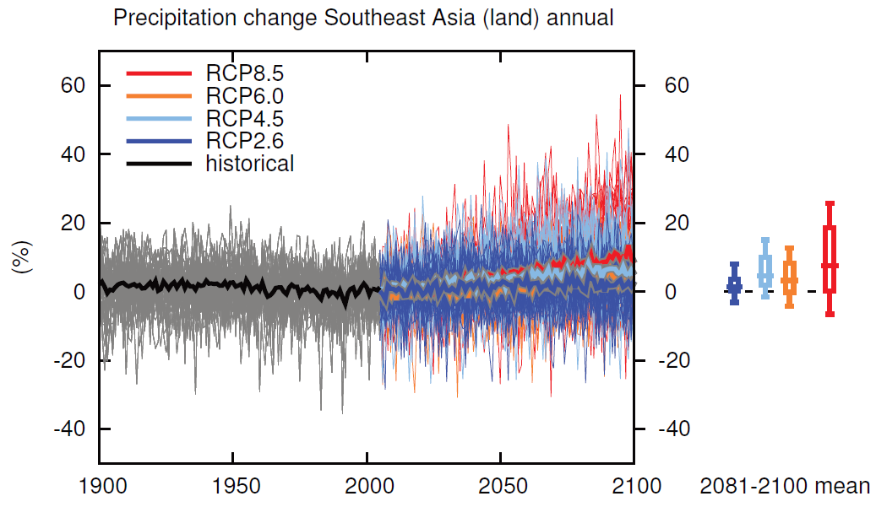
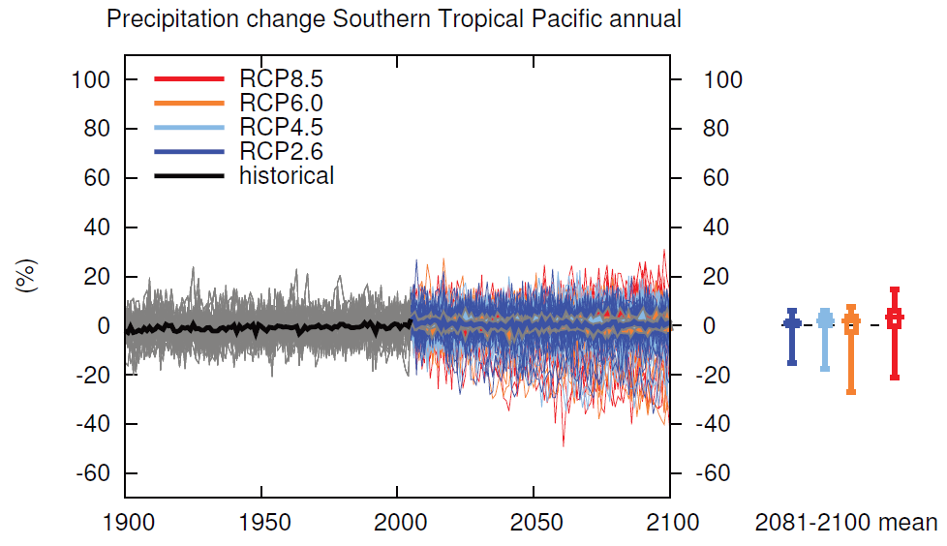
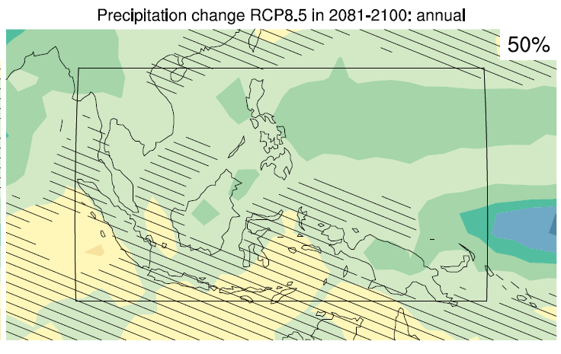
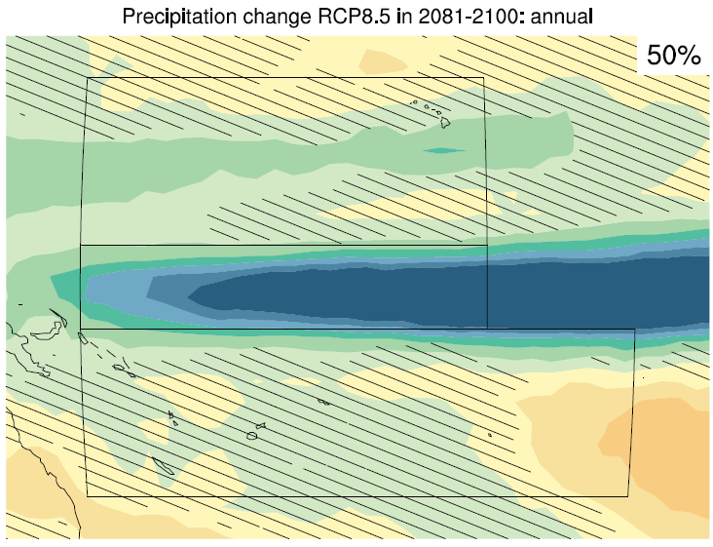
Rainfall change: 100 years

Slide 17
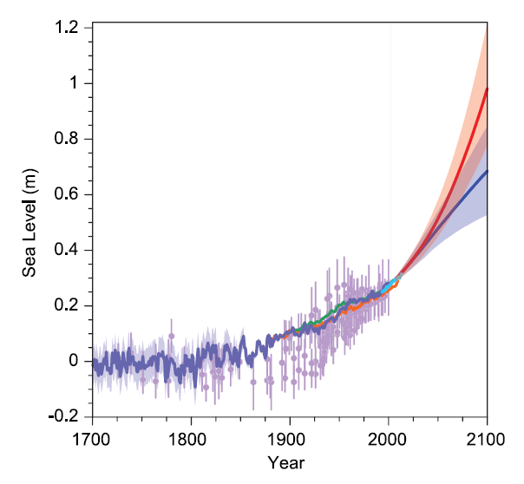
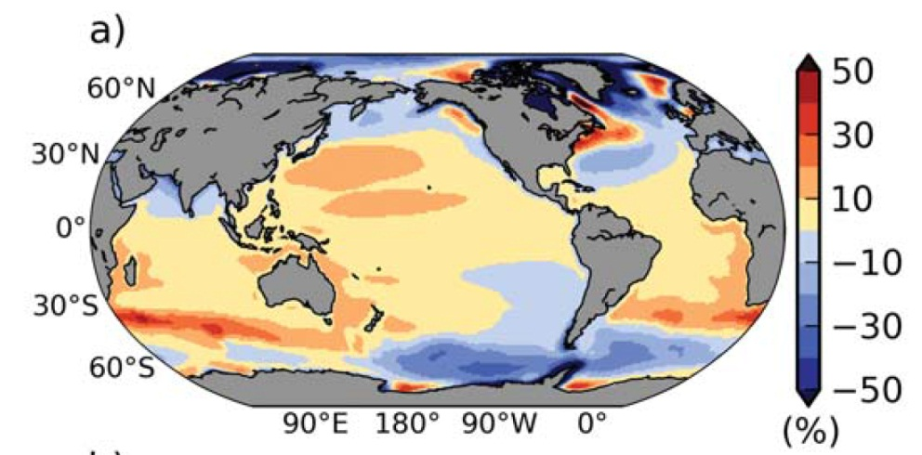
Sea Level Rise
RCP8.5
Between 60cm & 1m
Depending on emissions
Plus/minus 20cm
NZ add +10%
Possible range (NZ)
55cm to 1.3m by 2100
10m commitment?
RCP2.6
Notes:
Figure developed by Doug Ramsay early in 2009 from the information listed in Table 2.2 of the MfE Guidance Manual on Coastal Hazards and Climate Change.

Slide 18
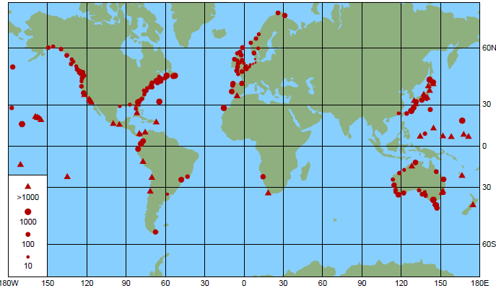
Coastal inundation
10cm SLR = triple the risk
The frequency of coastal inundation world-wide likely increases by 100 to 1000 times with ~50cm SLR (by 2100) –
Annual events become daily events
100-year events occur every few months

Slide 19
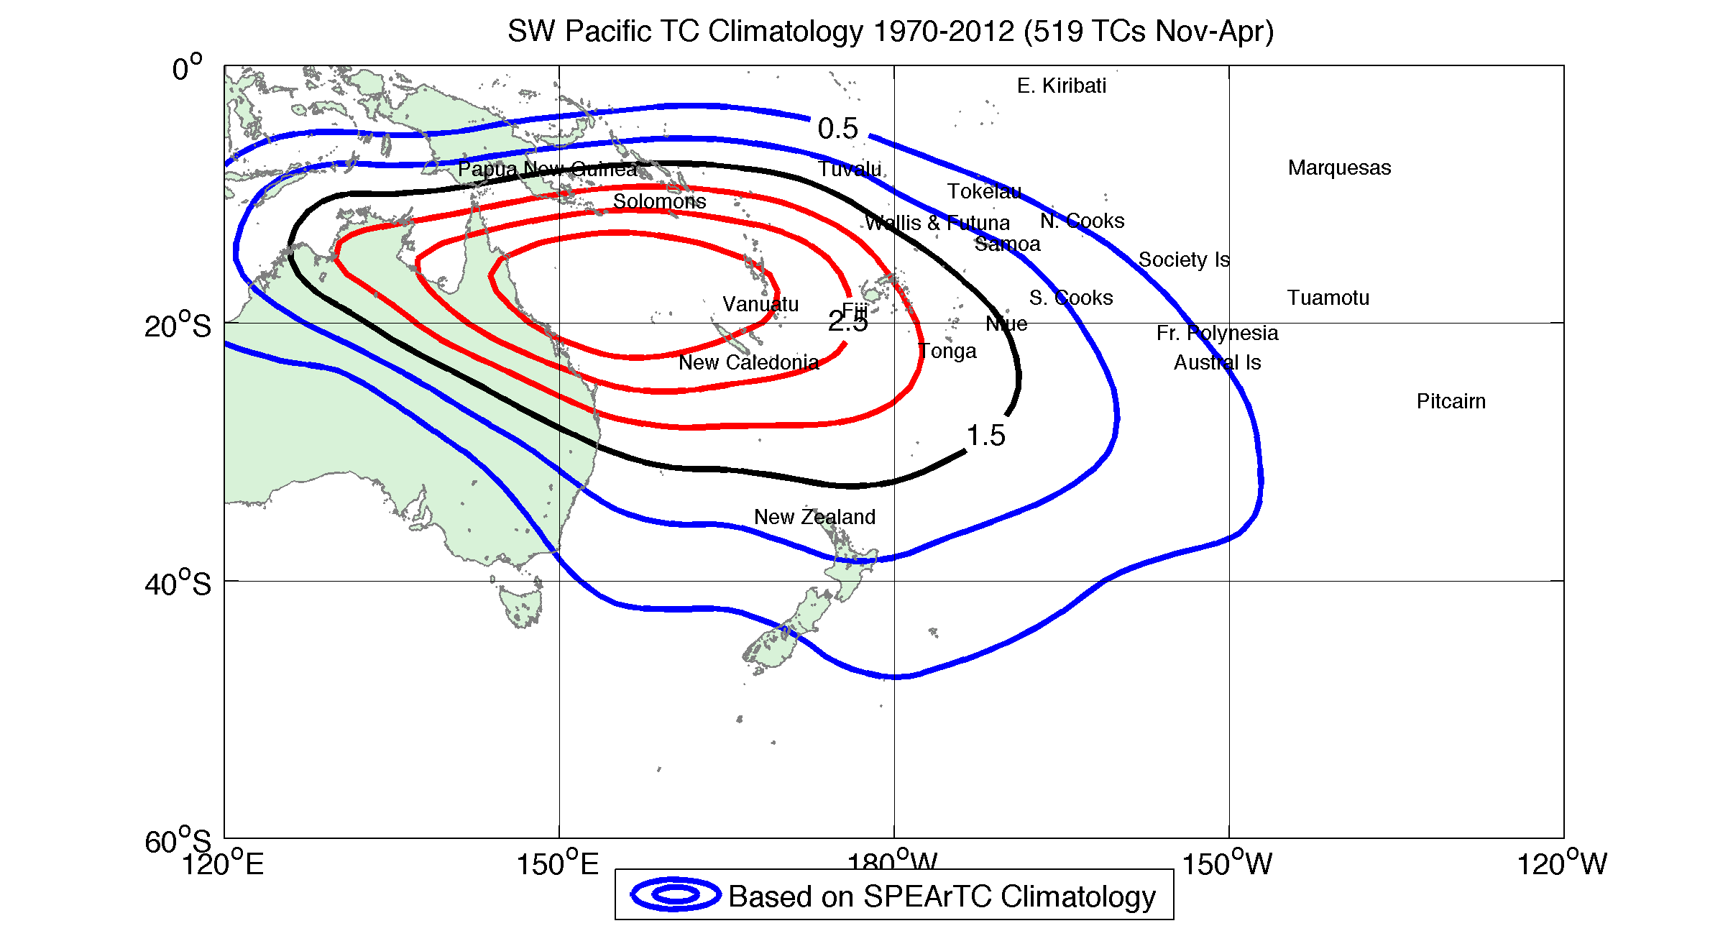
Tropical cyclone occurrence
Courtesy of Howard Diamond, NOAA/U. Auckland
Future location and occurrence may not change much
Intensity likely to increase

Slide 20
Legacy issues
‘Business as usual’ to 2100 likely to lead to 6-10°C of global temperature rise (next 500 years)
Melting of Greenland and West Antarctic ice sheets
Commitment over ~1,000 yr, recovery over ~10,000 yrs
Sea level rise of 10-20 metres
A climate not seen for millions of years
Billions of people at risk
Concerted mitigation efforts can avoid this
Zero emissions by 2100, preferably sooner

Slide 21
Reflections
Human influence on the climate system is clear
Climate change will persist for many centuries, even if carbon dioxide emissions are stopped.
Projected warming by 2100:
For RCP8.5 About as likely as not to exceed 4°C
For RCP2.6 67% probability to stay below 2°C
We have a choice
Thank You

